Slide 1

`
Convolutional Neural Network-Based Real-Time Object Detection and Tracking for Parrot AR Drone 2
Based on: A. Rohan, M. Rabah and S. Kim, “Convolutional neural network-based real-time object detection and tracking for parrot AR drone 2,” in IEEE Access, vol. 7, pp.69575-69584, May 2019.
Presenter: Ashish Kumar
Advisor: Prof. Yo-Ping Huang

Slide 2
CONTENTS
Introduction
Architecture of proposed system
Hardware specifications
OS overview
Object detection and tracking algorithm
Object detection
Object tracking
Results and Discussions
Future works
Conclusion

Slide 3
INTRODUCTION
An approach to detect and track the target object moving or still using SSD object detector for a UAV is presented.
Single Shot Detector (SSD)
Single shot : Task of object localization and classification are done in single forward pass of the network.
Detector: The network is an object detector which classifies those detected objects.
A CNN based on SSD architecture was trained to detect a single class. In case of single class detection, for training of CNN authors implemented a training method using positive (images with object) and negative (images without object) images.
Why SSD?
It aims to combine the performance of YOLO with the accuracy of region based detectors. It provides higher accuracy than YOLO.

Slide 4
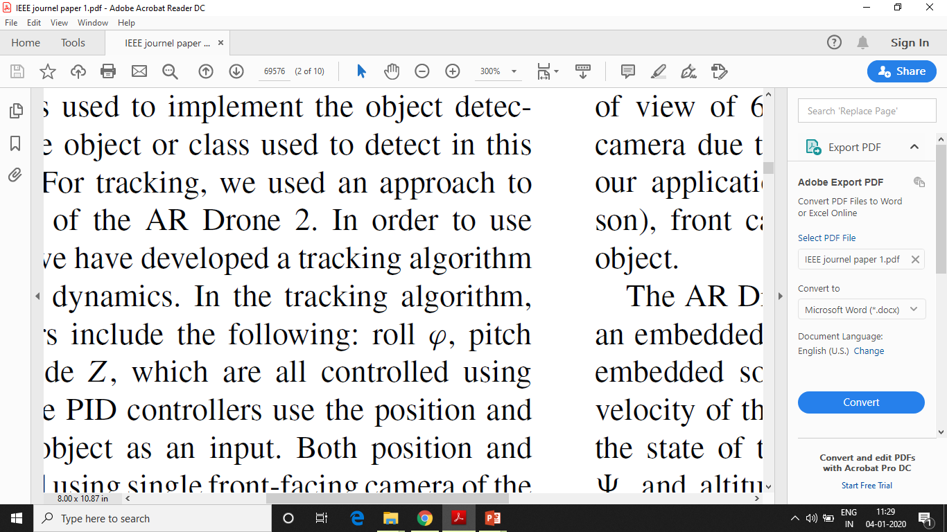
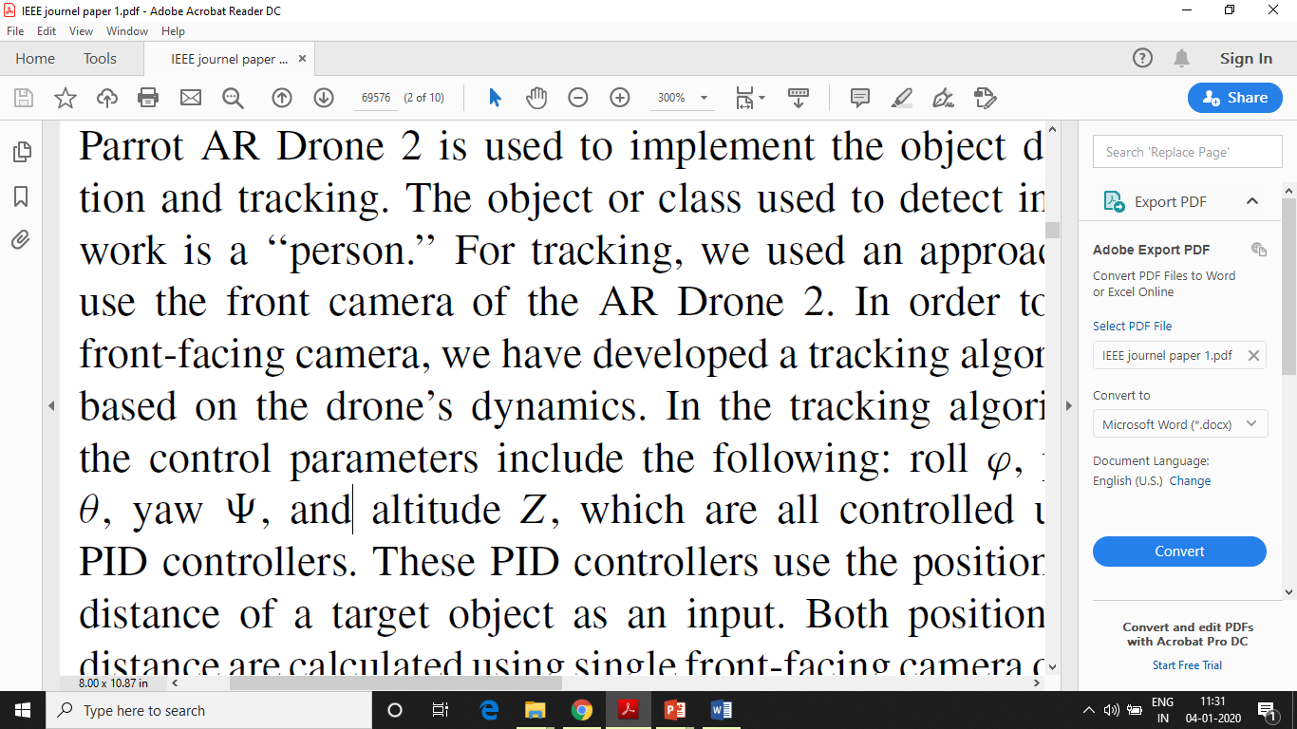
Problem with SSD is that the computational time is higher than other object detectors.
For gaining accuracy, SSD is implemented with optimization method where computational load is divided into CPU and GPU resulting in low computational time (10 ms) compared to normal time (27 ms).
Proposed system of authors was divided into two parts:
Object detection
Target tracking
Parrot AR drone 2 was used to implement object detection and tracking.
Front camera of drone was used for tracking. A tracking algorithm was made based on drone dynamics.
Control parameters in tracking algorithm: roll , pitch , yaw and altitude . Which were controlled using proportional integral derivative (PID) controllers.
PID controllers used the position and distance of target as input which were calculated using the single front facing camera of drone.

Slide 5
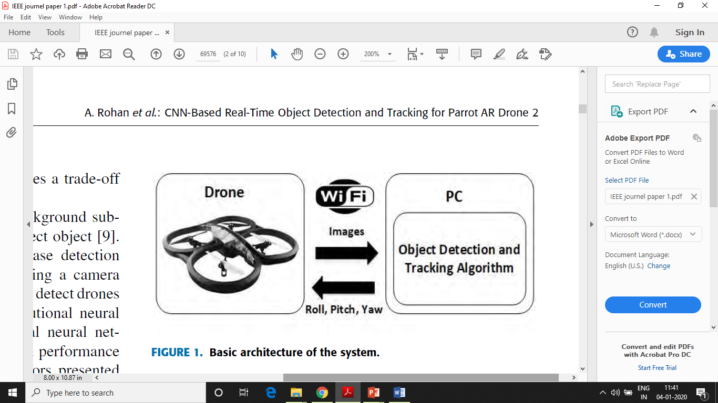
ARCHITECTURE
Drone sends images at a constant frequency of 30Hz.
Detected object position and distance are calculated to estimate control parameters by using PID controller based tracking algorithm.
Values are sent back to initiate the tracking process.

Slide 6
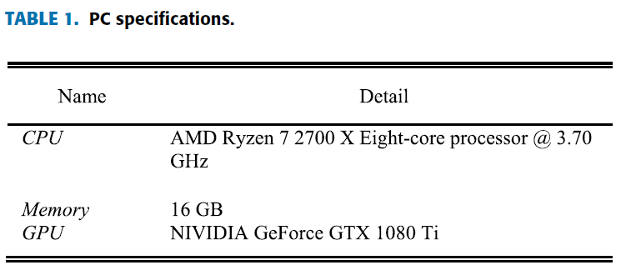
HARDWARE SPECIFICATIONS
Cost of parrot AR drone 2 : 400US$.
Drone size : 50 cm X 50 cm.
Weight : 500g.
Equipped with : two cameras, IMU including 3 axis gyroscope, 3 axis accelerometer, 3 axis magnetometer, a pressure sensor and an ultrasonic altitude sensor.
Front camera resolution : 1280 X 720 at 30fps with diagonal field of view of 92º.
Bottom camera resolution : 320 X 240 at 60fps with diagonal field of view of 64º.
Drone has 1 GHz ARM cortex – A8 CPU and embedded version of Linux OS.
Notes:
Camera used by authors is the front camera because of high resolution and it is front facing.
Embedded software on board measures horizontal velocity of the drone using bottom camera and estimate the state of drone, in terms of roll, yaw, pitch and altitude using available sensor information. Horizontal velocity is measured based on two features: one based on optical flow and other based on tracking image features(like corners).
All sensors movements were updated at 200Hz.
Drone can communicate with other devices using Wifi link. PC was used by authors to communicate with drone.

Slide 7
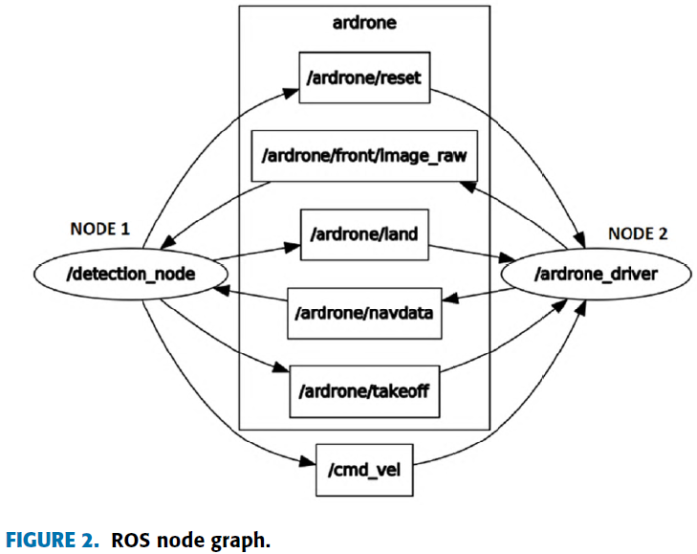
OPERATING SYSTEM OVERVIEW
Robot operating system (ROS) framework was used by authors to implement object detection and tracking algorithm.

Slide 8
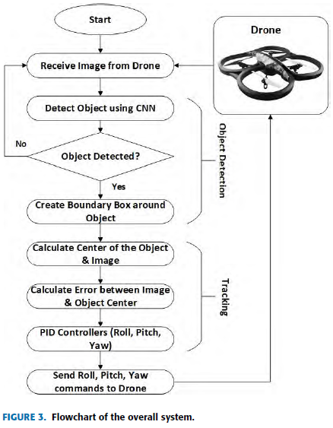
OBJECT DETECTION AND TRACKING ALGORITHM

Slide 9
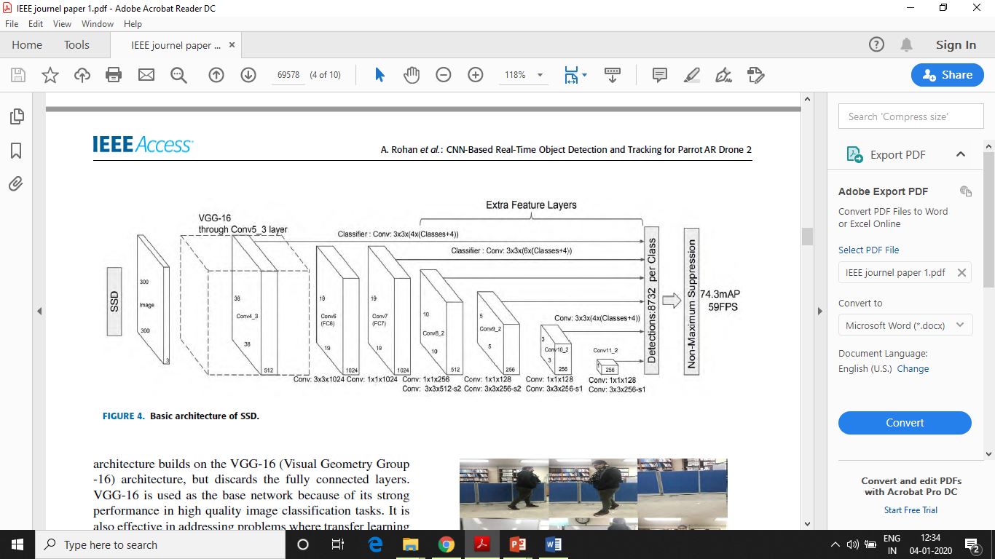
OBJECT DETECTION
VGG 16 is used because of strong performance in high quality image classification task.
Set of auxiliary convolution layers enable to extract features at multiple scales and decrease size of input to each layer

Slide 10
CNN TRAINING
CNN was trained to detect a single class not a specific one.
Image database was formed containing positive and negative images.
Authors took 5100 images with ratio 3:1(negative to positive images).
80% of images were used for training dataset while 20% were used for testing the network.
Network was trained for 50,000 iterations on PC.

Slide 11
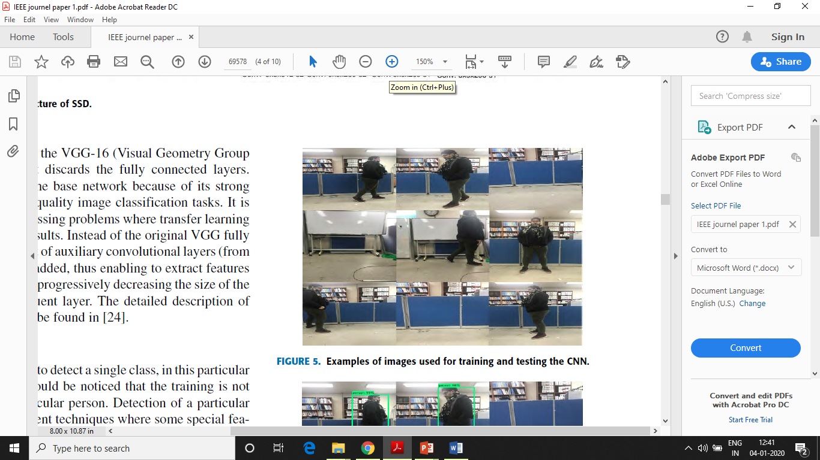
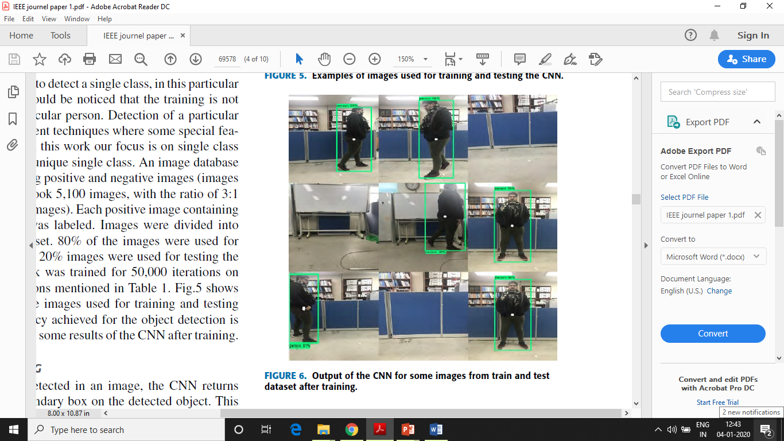

Slide 12
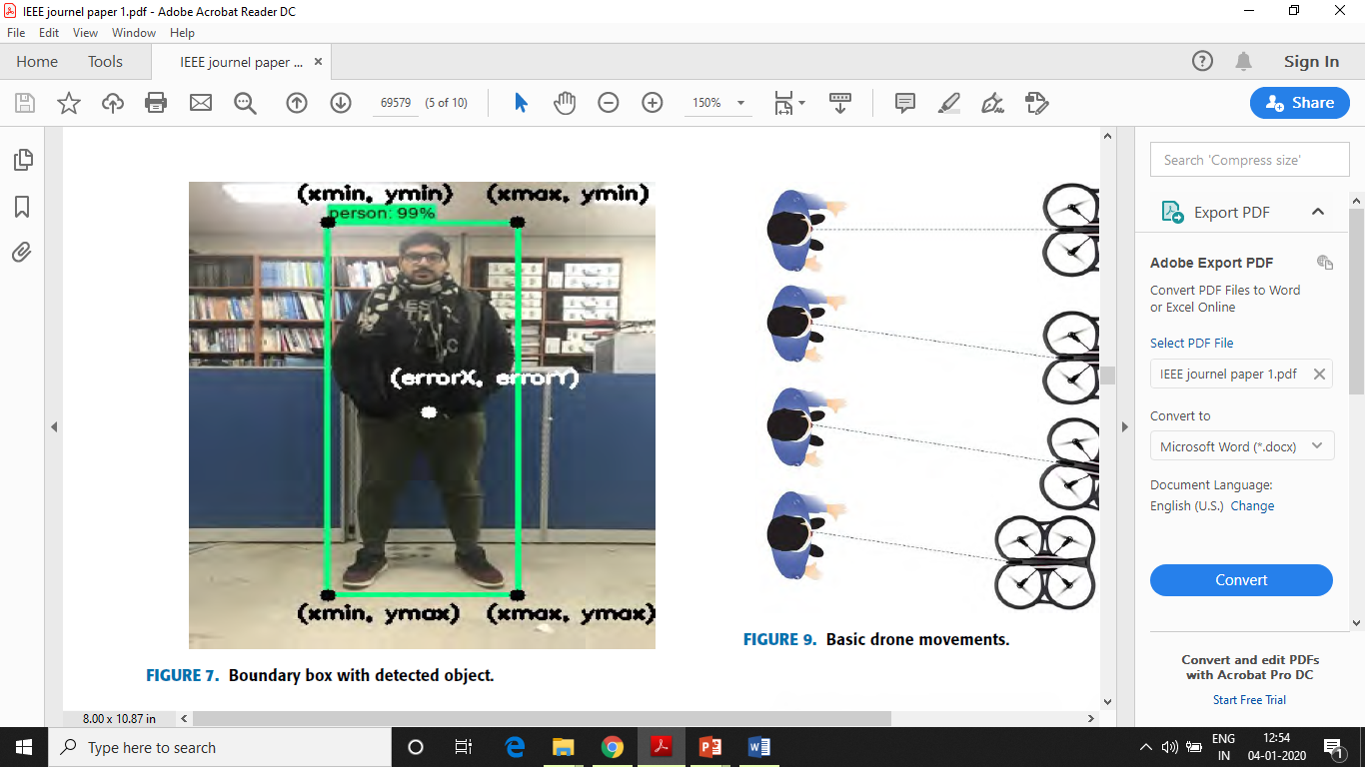
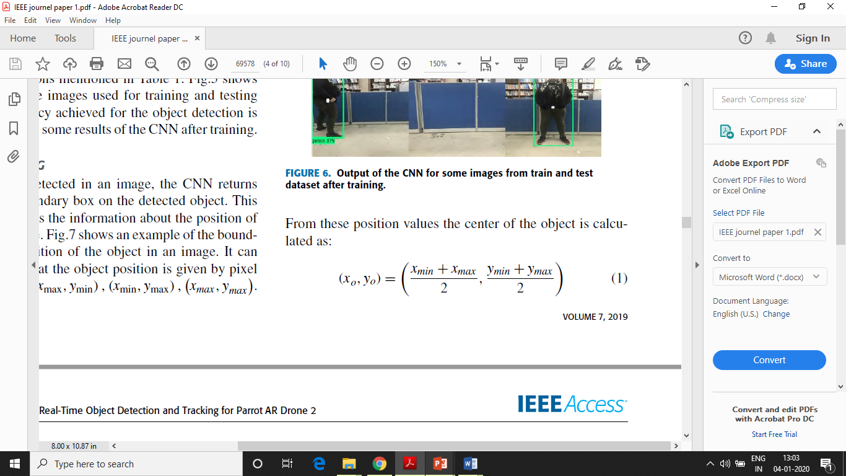
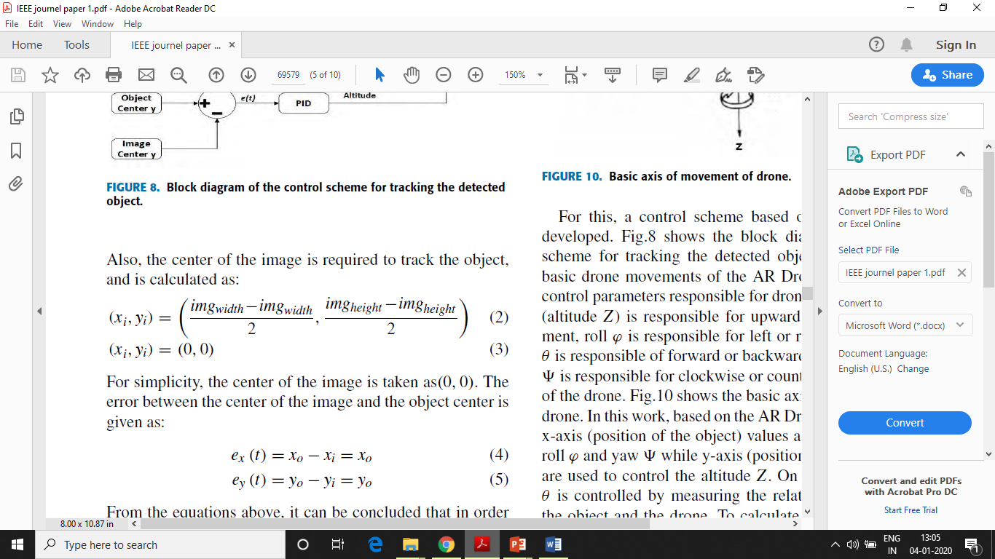
OBJECT TRACKING
Once object is detected CNN returns image with boundary box which contain information about position on object.
Object position is given by pixel value (x_{min} , y_{min})(x_{max} , y_{min})(x_{min} , y_{max})(x_{max} , y_{max})
From the position values centre of object is given by :
Centre of image required to track object is given by:

Slide 13
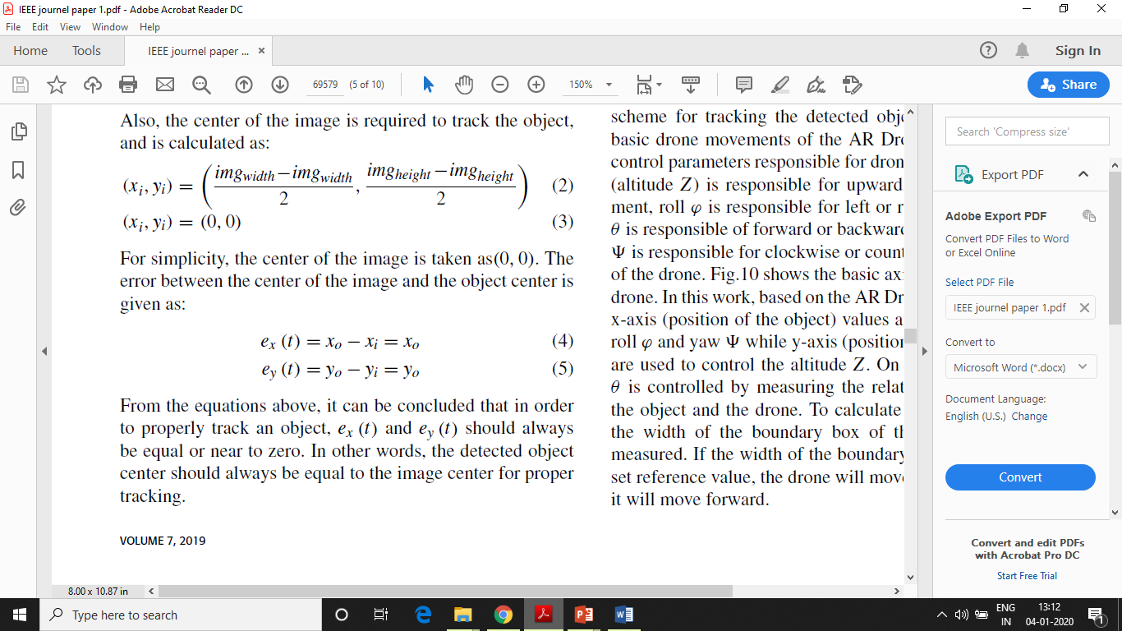
For simplicity centre of image is taken as (0,0).
Error between centre of image and object centre is given by:
For properly tracking object the detected object centre should always be equal to image centre.

Slide 14
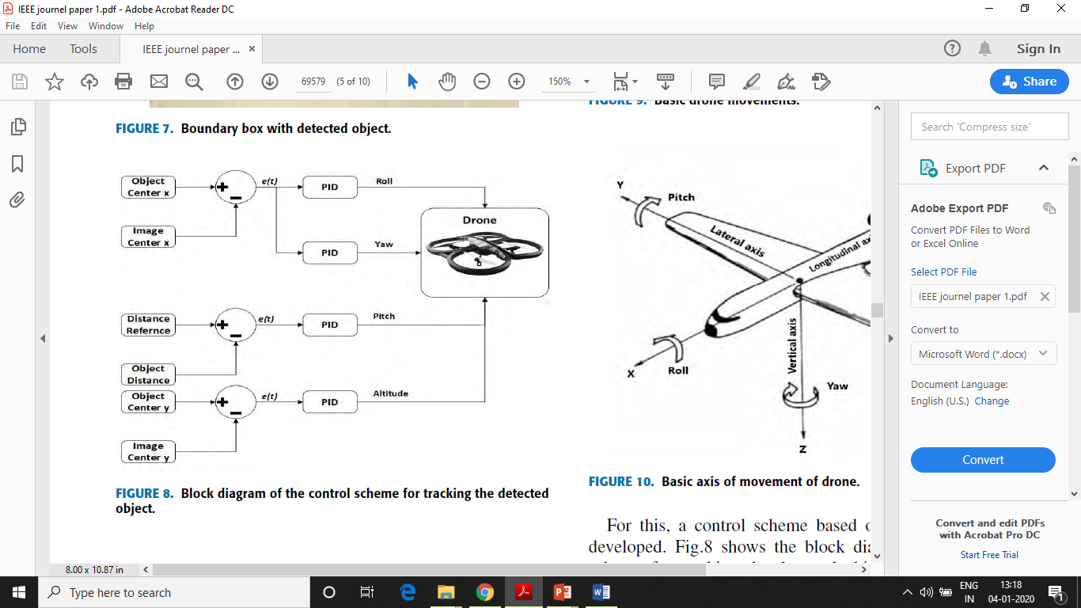
LEFT/RIGHT
ROTATION
FORWARD/BACKWARD
UP/DOWN

Slide 15
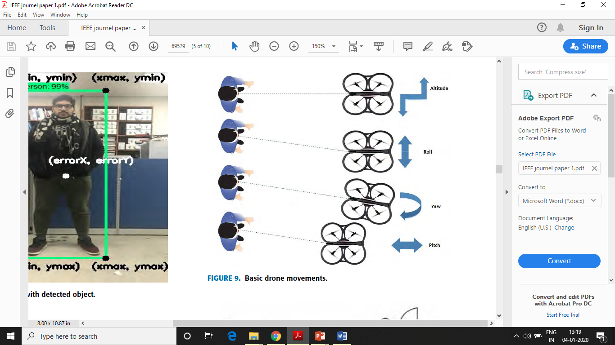
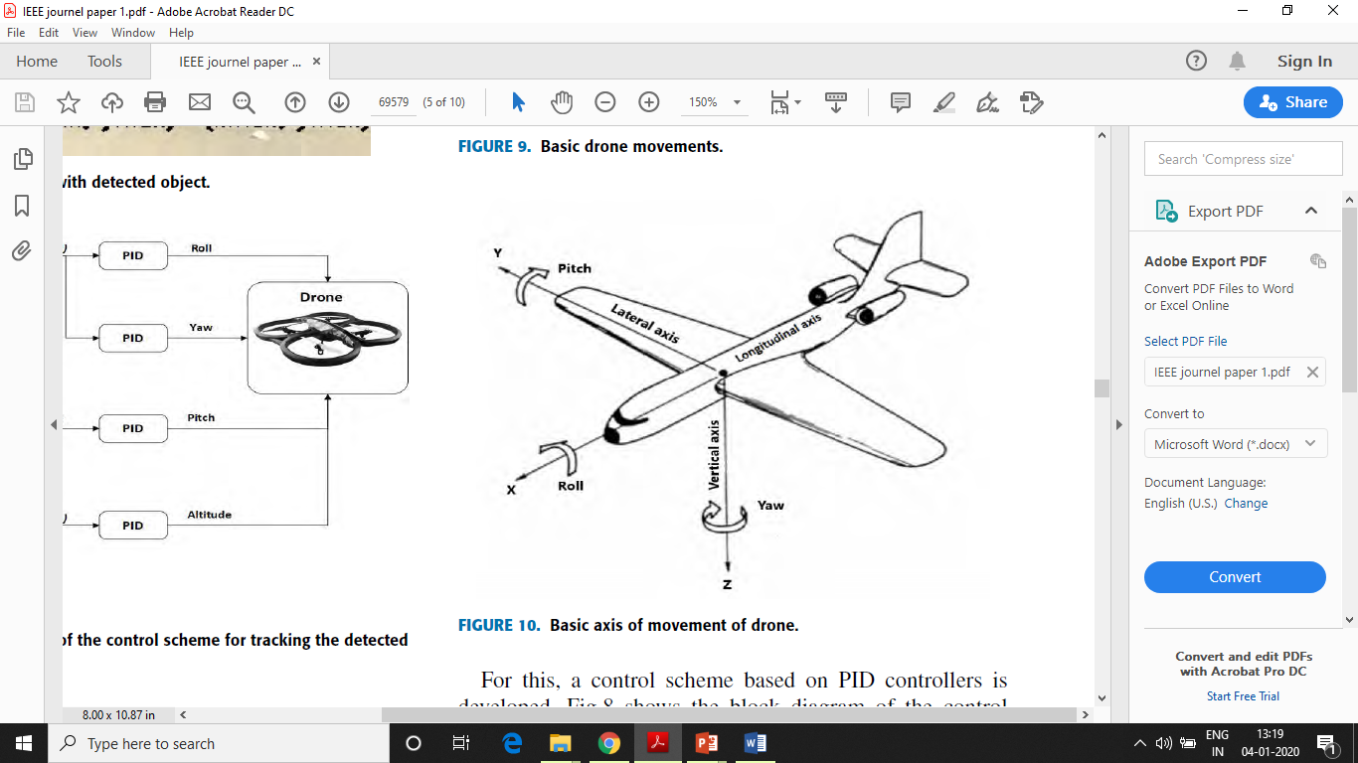
UP/DOWN
LEFT/RIGHT
ROTATION
FORWARD/BACKWARD

Slide 16
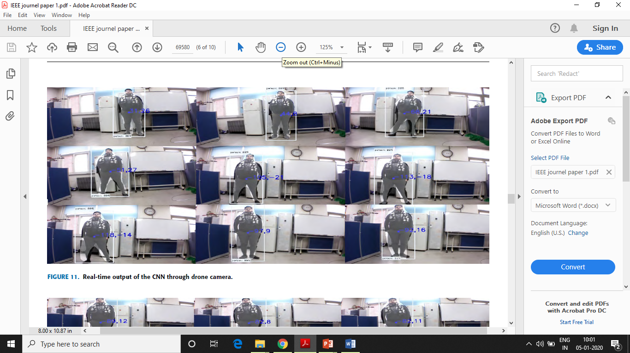
RESULT AND DISCUSSION
Authors used split model method to implement SSD architecture based CNN in real time to reduce computational time of object detector.
Time taken by objet detector to process a frame and give output on the detected object was 10ms which is 2.7 times less than normal computational time of SSD(27ms).
Frame per second achieved was 58fps.

Slide 17
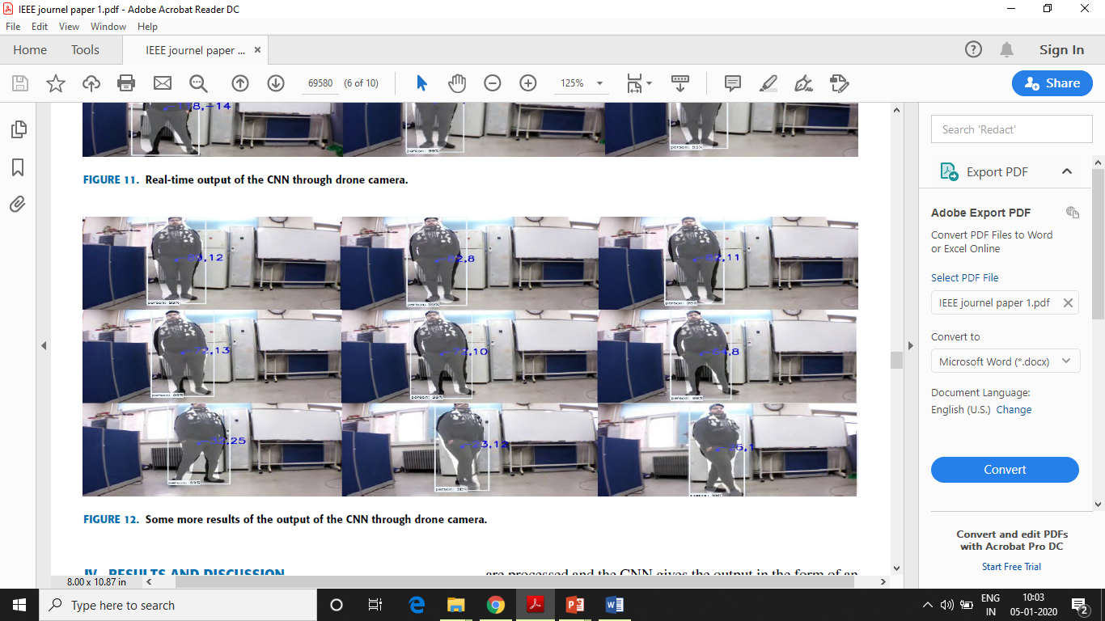
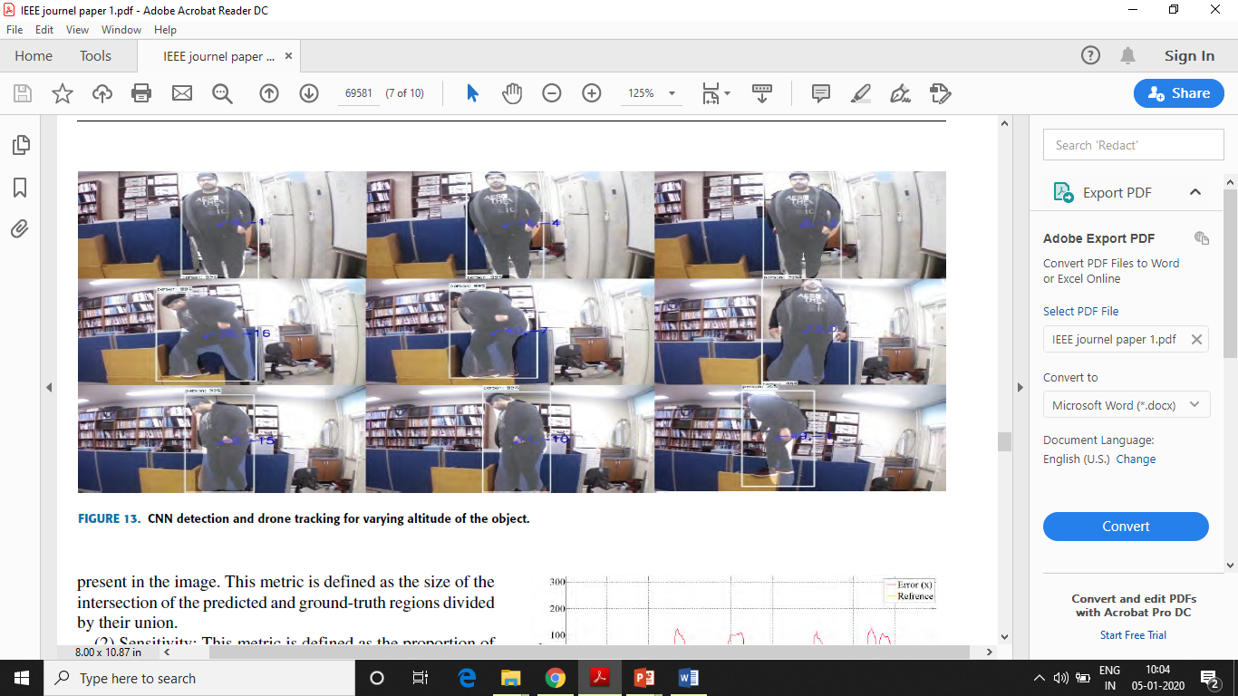
Notes:
From fig. 11 12 13 it can be seen that the object keeps on moving but the drone always keeps target object in the centre of image and continue to track the object.

Slide 18
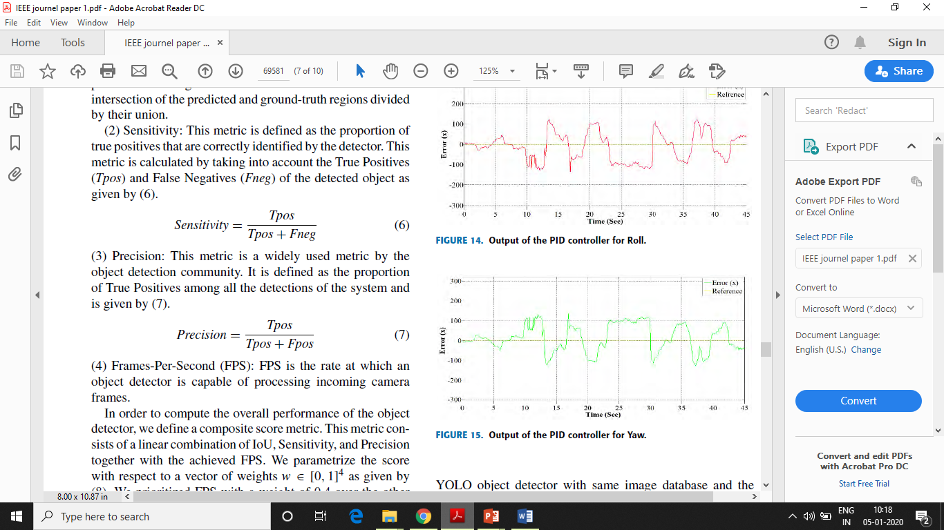
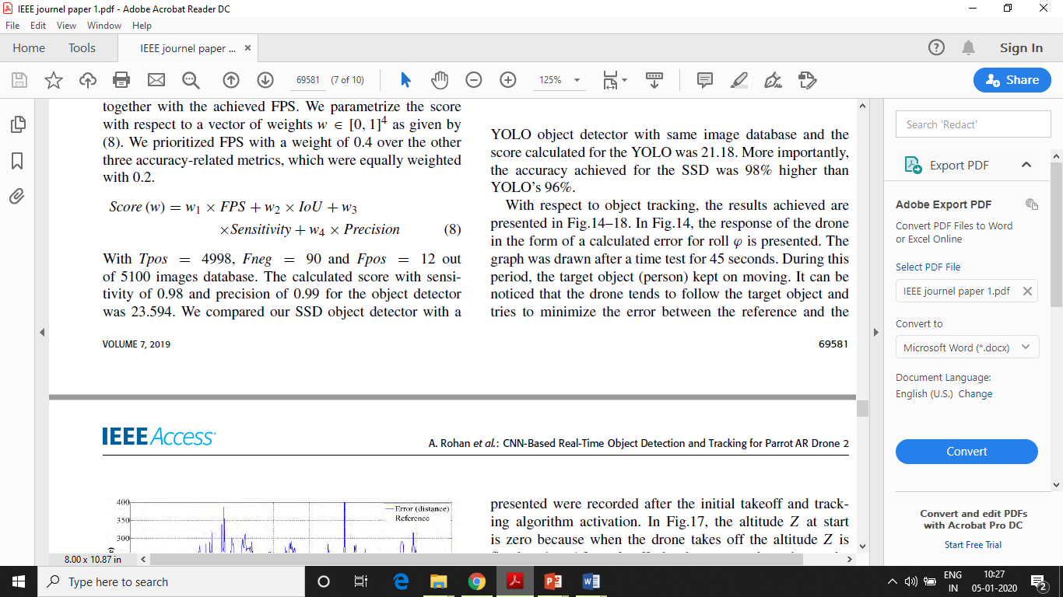
Evaluation of object detector applied following 4 metrics:
IOU – It captures the similarity between the predicted region and ground truth region for an object present in image.
IOU = Size of intersection of predicted and ground truth regions
Union of predicted and ground truth regions
Sensitivity – Defined as proportion of true positives that are correctly identified by the detector.
Precision – Defined as proportion of true positives among all the detections of the system.
FPS – Rate at which object detector is capable of processing incoming camera frames.
Overall performance of object detector is given by composite score metric. Score was parameterized with vector of weights w [0,1]⁴.
Notes:
Authors prioritized FPS with a weight of 0.4 over other there accuracy related metrics which were equally weighted with 0.2

Slide 19
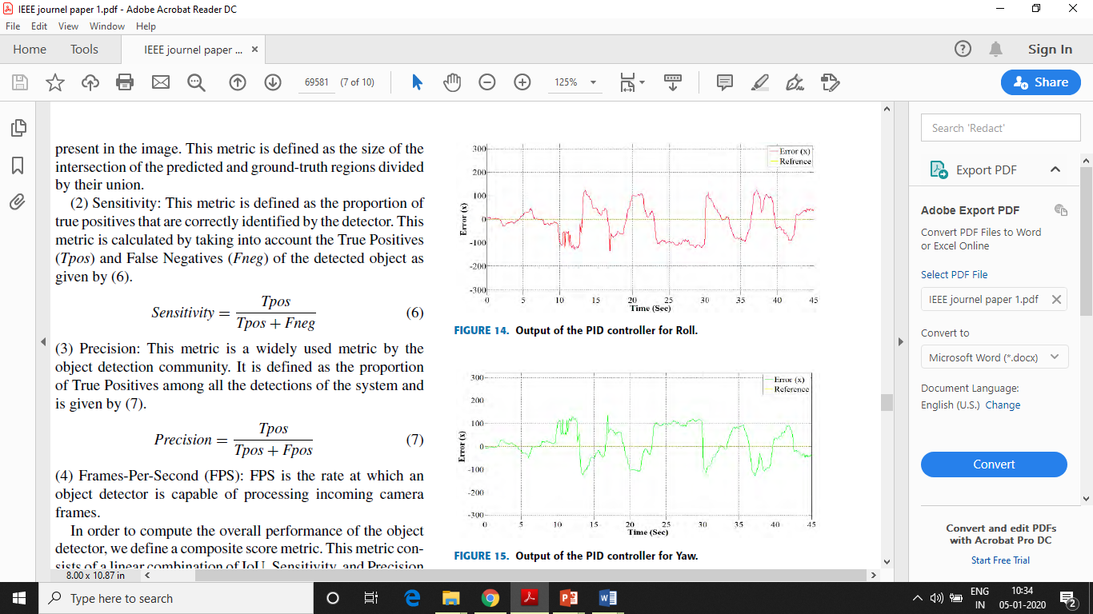
With Tpos – 4998, Fneg – 90 and Fpos – 12 out of 5100 images having precision – 0.99 and sensitivity – 0.98 for object detector the calculated score was 23.594.
Results of SSD were compared with YOLO with same database and score was 21.18. Accuracy of SSD – 98% higher than YOLO – 96%.
Response time of drone in form of calculated error for roll is presented.
Graph was drown after rest of 45 sec.
Object kept on moving during this period and drone follows object and tends to minimize the error.
Response time of drone in form of calculated error for yaw is presented.

Slide 20
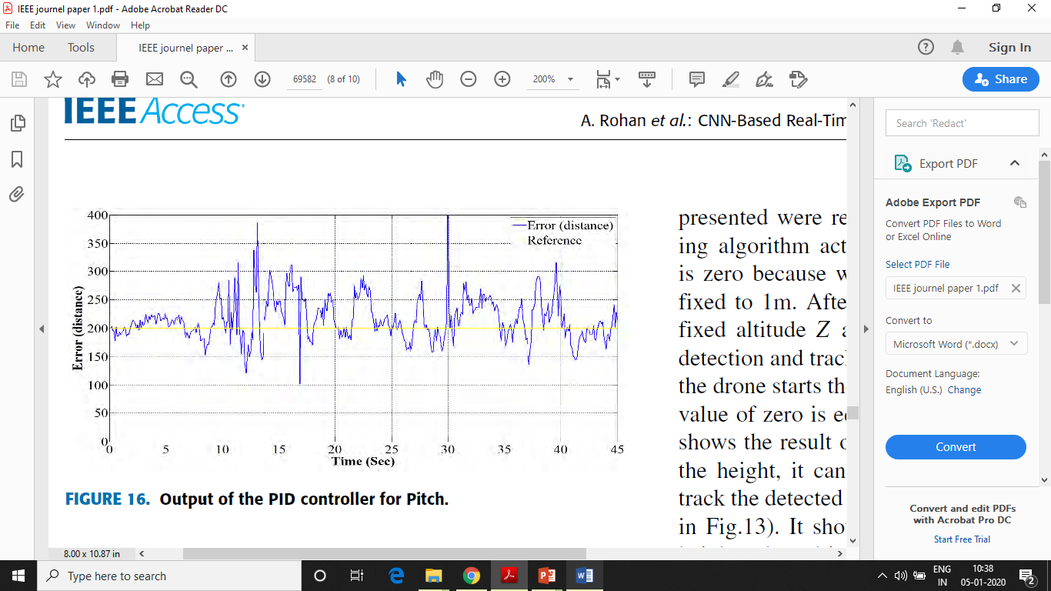
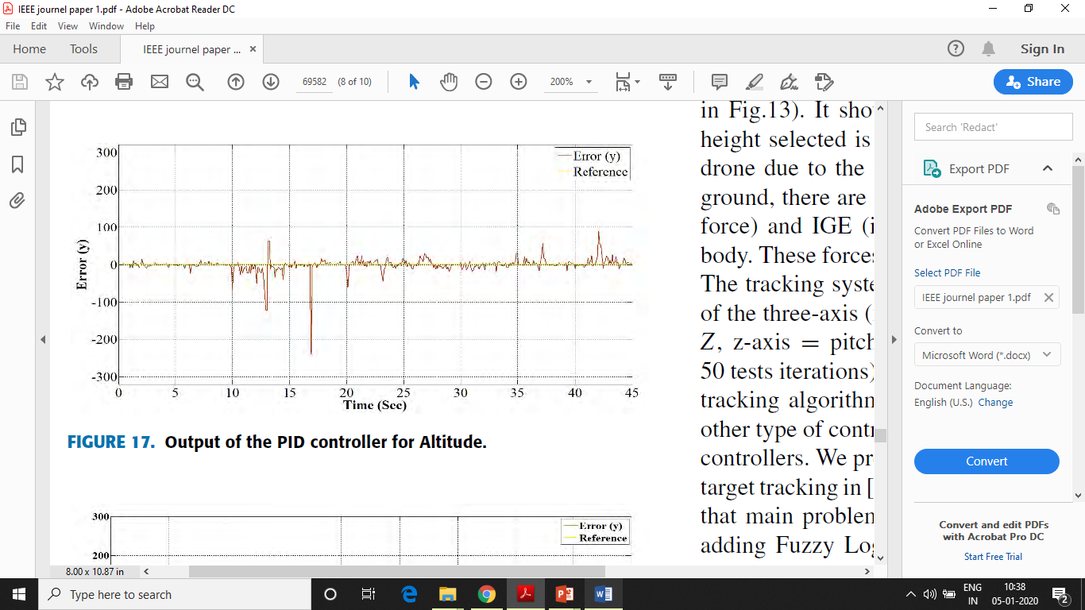
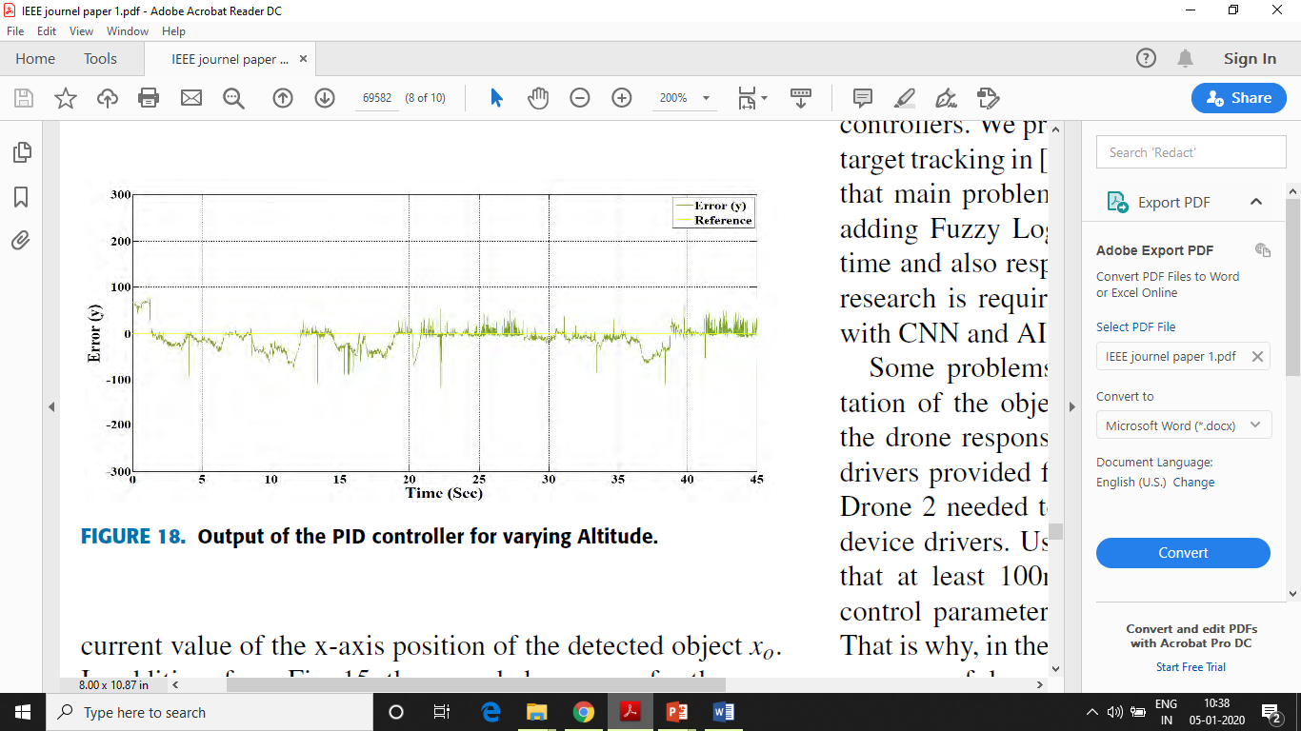
Pitch error changes according to movement & distance of object and drone.
Relative distance fixed – 1 m.
It starts from 0 as drone takes off & wait for tracking algorithm to work. Altitude was fixed to 1m initially.
Shows result when detected object changed height.
Disturbance because of OGE (outer ground forces) and IGE (inner ground forces).

Slide 21
FUTURE WORK
From this research results authors are trying to implement object detection and tracking algorithm for an application of bridge surveillance to detect structural cracks.
Problem such as object detector missed detection in this work will also be solved by introducing some trackers to smooth detection process and fuzzy logic will be used to control drone in tracking.
Authors said using fuzzy logic or fuzzy PID controllers would increase the computational time of drone so further research can be done to implement those kind of controllers.

Slide 22
CONCLUSION
Authors have developed an approach which can be implemented in real time and advantages of high accuracy of SSD architecture can be used by reducing computational time.
Efficiency achieved in object detection was 98% while in tracking was 96.5% which is very reasonable for a complex system like drone.

Slide 23
Thank You

